Slide 1
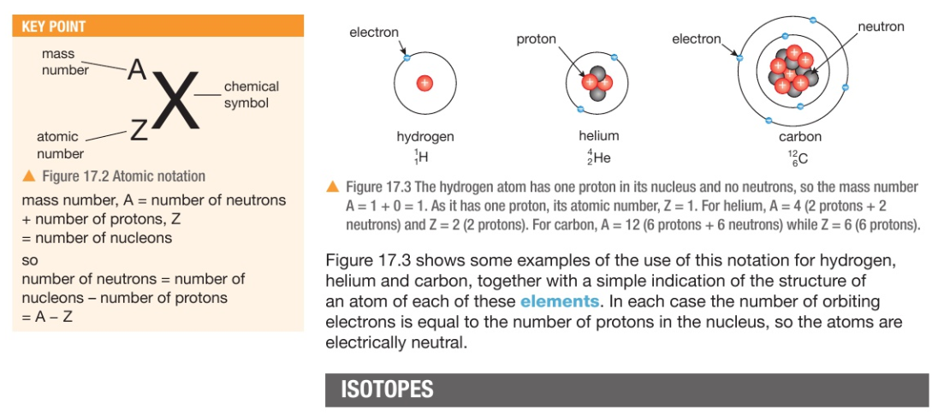
Radioactivity and particles

Slide 2
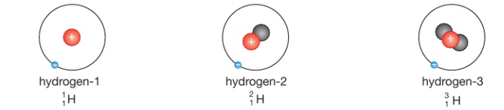
Radioactivity and particles
Isotopes: atoms of the same element with a different number of neutrons

Slide 3
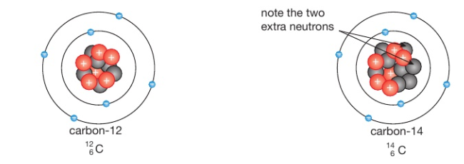
Radioactivity and particles
Isotopes: atoms of the same element with a different number of neutrons

Slide 4

Radioactivity and particles
Exercise: Fill-in the missing for each of the following:
${}_{Z}^{16}O {}_{6}^{12}X$ ${}_{3}^{A}{Li}$ ${}_{Z}^{20}{Ne}$ ${}_{20}^{40}X$ ${}_{}^{207}{Pb}$

Slide 5
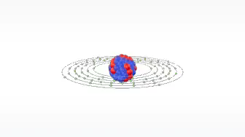

Radioactivity and particles
Exercise: classify each of the following as stable or radioactive ?
${}_{9}^{19}F {}_{6}^{12}C$ ${}_{6}^{14}C$ ${}_{53}^{127}I$ ${}_{53}^{131}I$ ${}_{82}^{207}{Pb}$

Slide 6
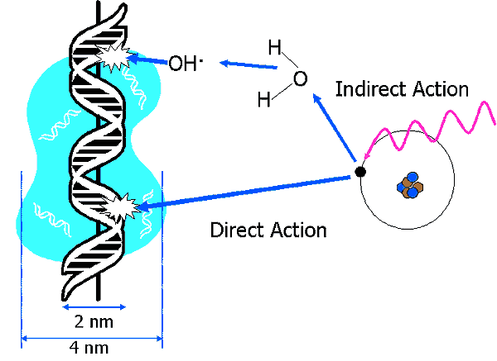
Radioactivity and particles
Ionizing radiation: causes a gain or loss of electric charge in materials

Slide 7
Types of ionizing radiation
Radioactivity and particles
Radioactivity is a random process..
Some atoms emit αlpha particles when decaying,
Some atoms emit βeta particles when decaying
Some atoms emit γ (gamma) energy when decaying

Slide 8
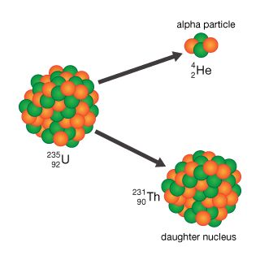
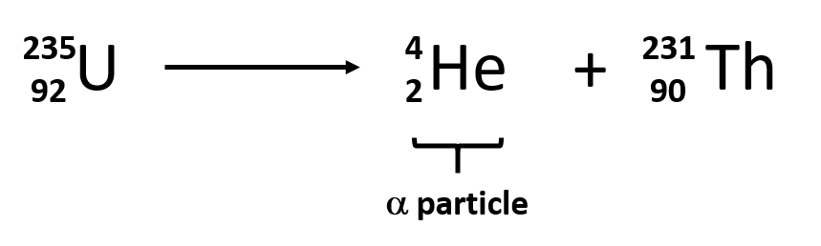
α decay
Radioactivity and particles
Example of elements undergoing α decay:
The atom loses 4 mass numbers and 2 atomic number
So, α decay during A-4 , Z-2
Usually, very heavy atoms give alpha particles to become lighter

Slide 9
α decay
Radioactivity and particles
Because they are highly ionizing, αlpha particles have a limited range of a few 2-8 cm in air.
  So, alpha particles easily collide and interact with atoms and are stopped more easily.
  Alpha particles are helium ions (positively charged +2)
  Alpha particles can be stopped by a sheet of paper
  alpha decay : A-4 , Z-2

Slide 10
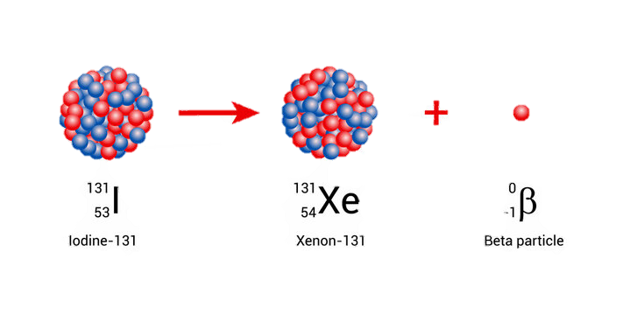
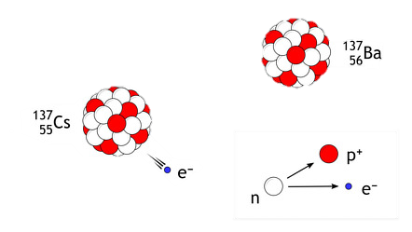
β decay
Radioactivity and particles
Is the emission of an electron from the decay in the nucleus.
  The β particle (an electron)
  Electrons are much lighter and smaller than α particles
  Electrons have a charge of -1 , so they have a longer range
  Most βeta particles can be stopped by aluminum foil
  Beta decay converts a neutron to a proton
    Z + 1
Electrons are 2000 times lighter than protons
Notes:
1/2000th the mass of a proton or neutron

Slide 11
γ decay
Radioactivity and particles
γ decay involves the emission of γ-rays (energy not a particle) in the form of very high energy photons.
  γ-rays are uncharged
  γ-rays are not particles, so they seldom interact with atoms
  So, γ-rays have a very long range

Slide 12
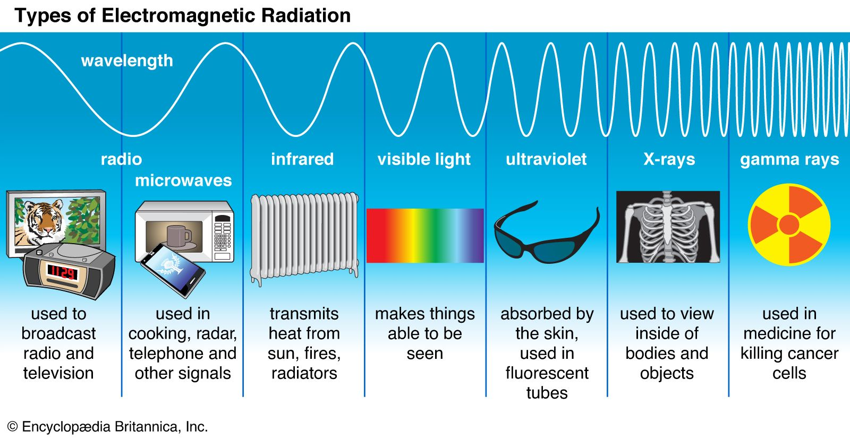
γ decay
Radioactivity and particles
γ decay involves the emission of γ-rays (energy not a particle) in the form of very high energy photons.
  γ-rays are uncharged
  γ-rays are not particles, so they seldom interact with atoms
  So, γ-rays have a very long range

Slide 13
Radioactivity and particles
Name of decay | Emitted particle | Range in air | Ionizing potential | Stopped by
α decay | Helium ⁺² | Low (2- 8 cm) | High | A sheet of paper
β decay | Electron ⁻¹ | Medium (50cm–1m) | Medium | Aluminum foil
γ decay | Gamma energy | High (several meters) | Weak | Thick lead sheet

Slide 14
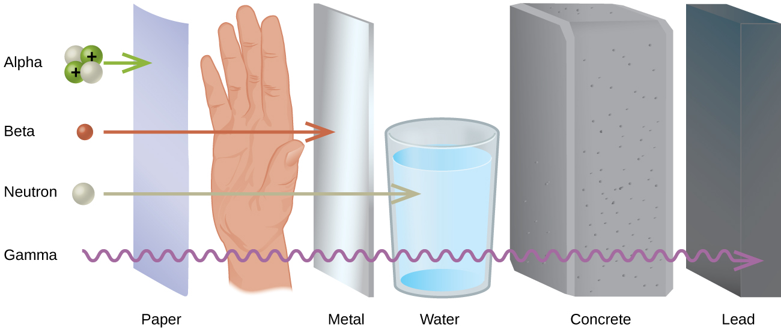
Radioactivity and particles

Slide 15
Radioactivity and particles
Because they are highly ionizing, αlpha particles have a limited range of a few 2-8 cm in air.
  So, alpha particles easily collide and interact with atoms and are stopped more easily.
  Alpha particles are helium ions (positively charged +2)
  Alpha particles can be stopped by a sheet of paper

Slide 16
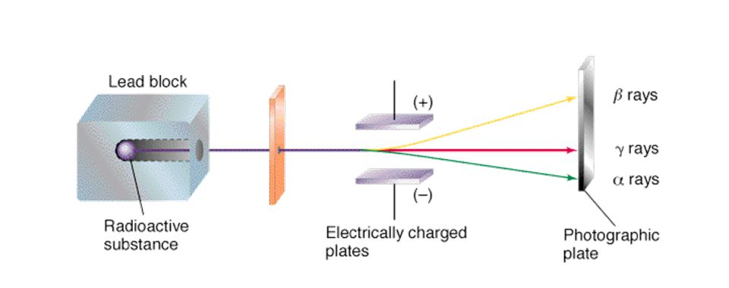
Radioactivity and particles

Slide 17
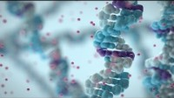
Radioactivity and particles

Slide 18

Radioactivity and particles

Slide 19
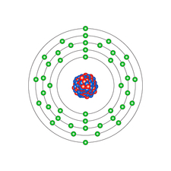
Radiation and Half-life
Radioactive elements tend to decay over time, the decay is a random process independent of chemical compounds or temperature.
Some elements decay more quickly than others, other elements take longer to decay
  example
Half-life: 12.3 years
Half-life: 6 hours

Slide 20
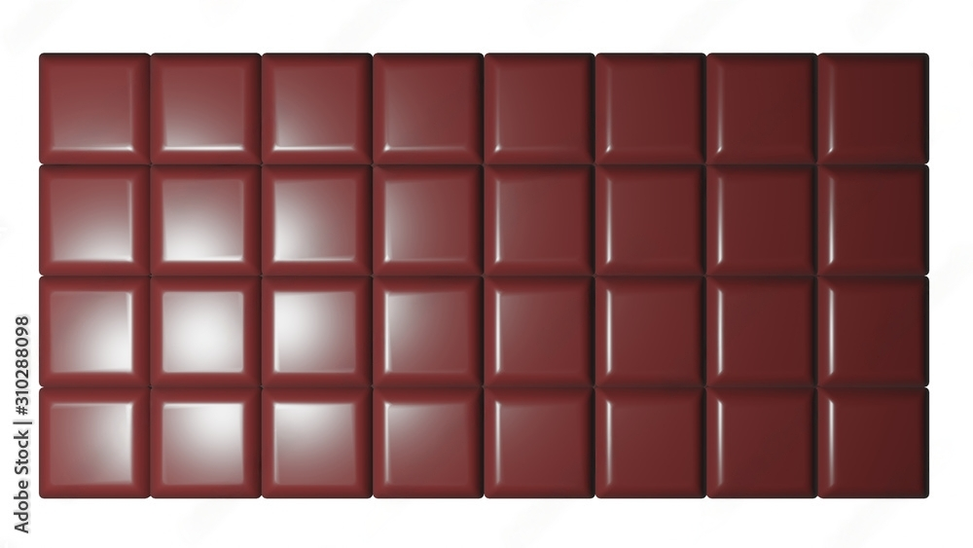

Radiation and Half-life
Half-life is the amount of time it takes for half of a sample of a radioactive substance to decay.
Chocolate bar example half life: 3 hours

Slide 21
Radiation and Half-life
Half-life is the amount of time it takes for half of a sample of a radioactive substance to decay.
Chocolate bar example half life: 3 hours

Slide 22
Radiation and Half-life
Half-life is the amount of time it takes for half of a sample of a radioactive substance to decay.
Chocolate bar example half life: 3 hours

Slide 23
Radiation and Half-life
Half-life is the amount of time it takes for half of a sample of a radioactive substance to decay.
Chocolate bar example half life: 3 hours

Slide 24
Radiation and Half-life
Half-life is the amount of time it takes for half of a sample of a radioactive substance to decay.
Chocolate bar example half life: 3 hours

Slide 25
Radiation and Half-life
Radioactive elements tend to decay over time, the decay is a random process independent of chemical compounds or temperature, but depends on the isotope (element) itself
Some elements decay more quickly than others, other elements take longer to decay
Half-life: 12.3 years
Half-life: 6 hours

